Slide 1

Borislav Statev
Senior Flutter Developer at Via Transportation
Smooth transitions between screens in Flutter

Slide 2
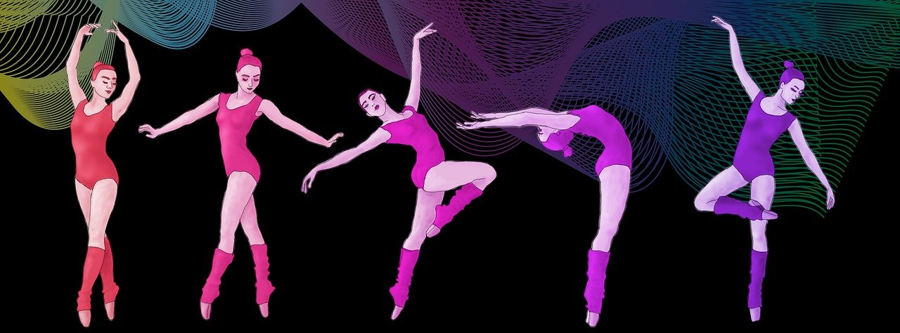
Move between screens like a dancer
- 2 steps forward, 1 step back
- Don’t forget back transition
- Timely, without delay
- Consistent

Slide 3
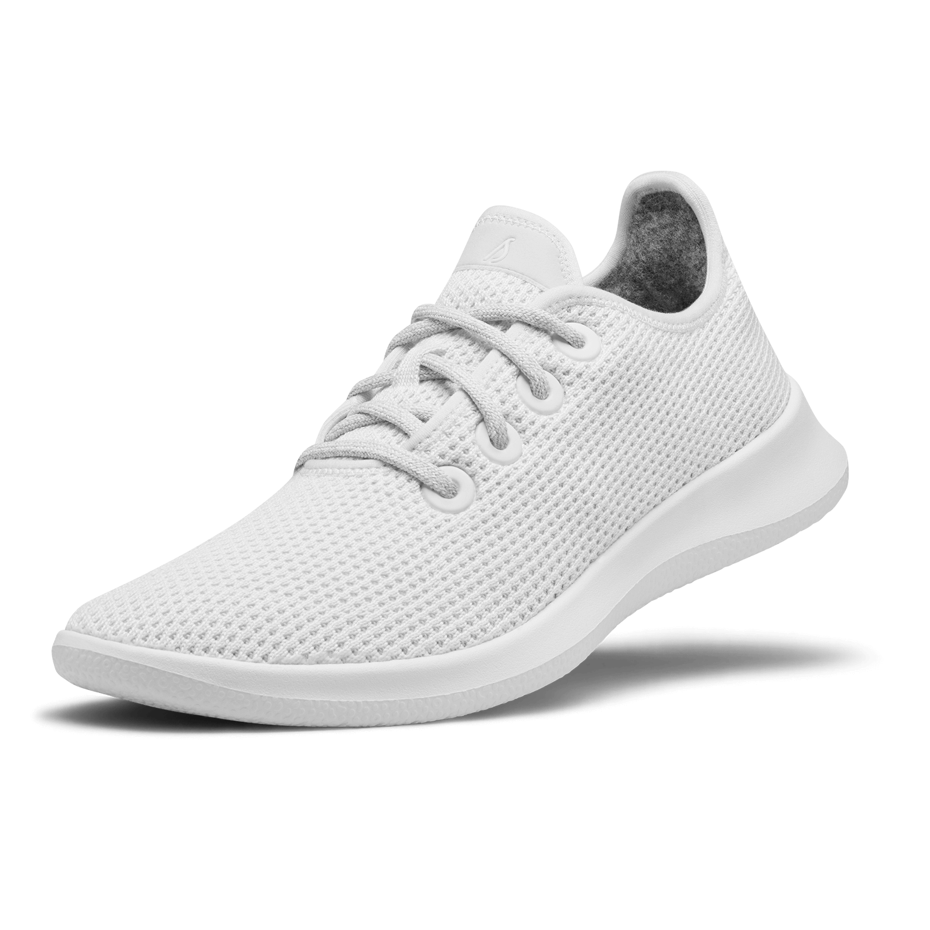

Put on your Flutter shoes
Get a Navigator
- Use a PageRoute

Slide 4

Start with the basic
Using MaterialPageRoute
Android vs iOS

Slide 5

Create your dance
Use PageRouteBuilder
Extend PageRouteBuilder
Change Duration
Forward and Backward

Slide 6
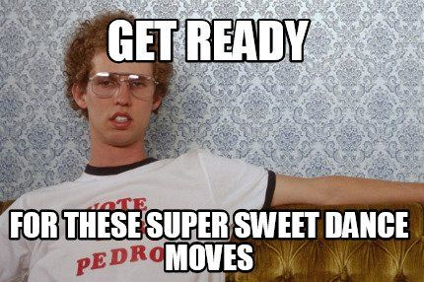
Build-in moves
Transitions
Scale, Fade, Rotation, Slide

Slide 7
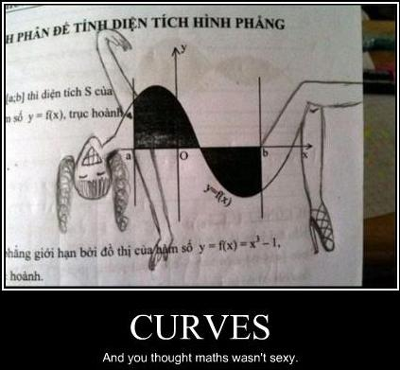
Build-in moves
Transitions
Scale, Fade, Rotation, Slide
Animation Curve

Slide 8
Build-in moves
Transitions
Scale, Fade, Rotation, Slide
Animation Curve

Slide 9
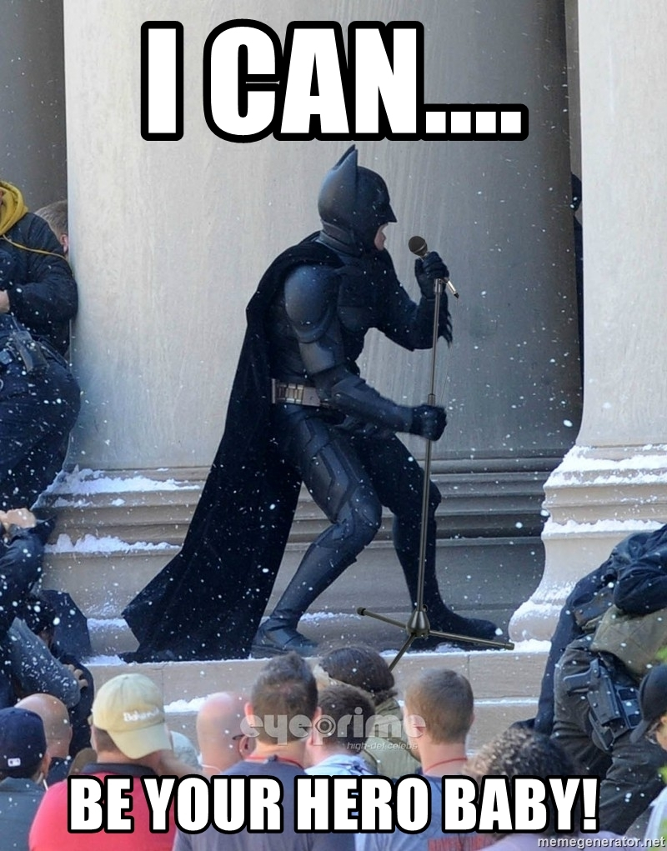
Be a hero at the floor
What is Hero animation?
- How to use it?

Slide 10
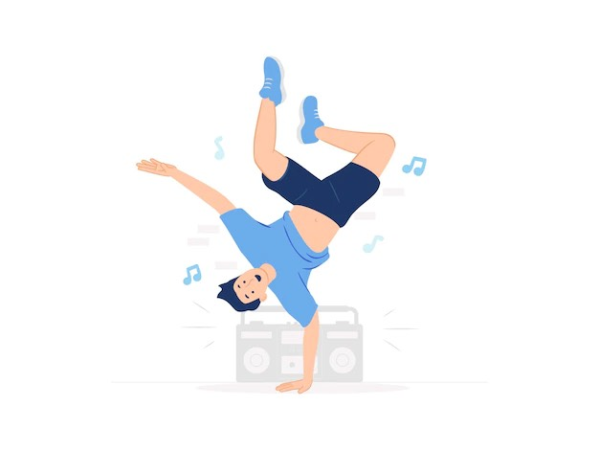
Freestyle
Combine multiple transitions
Interval of execution
- Create your own transition

Slide 11
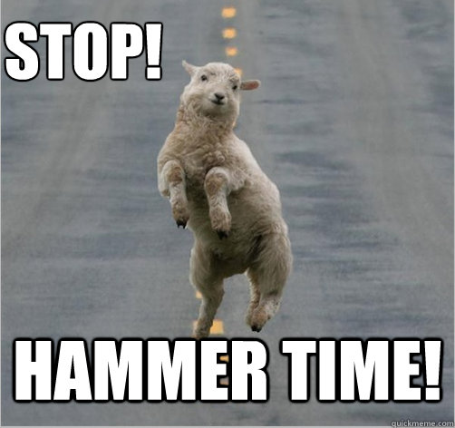
You CAN touch this
Handle user gesture
Communicate between the gesture and the transition

Slide 12
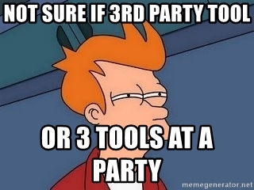
Advanced choreography
Additional 3rd party libraries
page_transition
animations
concentric_transition

Slide 13





Contacts:
borislav-statev
bstatev1
BobbyStatev
bstatev

